Slide 1
医学病毒学
Principles of Medical Virology

Slide 2
课程内容
第一部分: Chapter 1. Introduction to medical virology
第二部分: 关于《医学病毒学》课程

Slide 3
课程中文名称:医学病毒学
课程英文名称：Principles of Medical Virology
课程类别：专业选修
课程学分数：2学分
课程学时数：36学时
授课对象：三年级本科生
本课程的前导课程：微生物学，分子生物学，细胞生物学，病毒学
授课时间：周二 3-5节（从第五周开始）

Slide 4
教学目的
本课程是一门生命科学学院本科生的专业选修课。目的是使学生在了解病毒学基本理论知识的前提下，更加系统深入的学习医学病毒学的理论知识。以一系列导致重要人类疾病的、或在生物医学上有重要应用的病毒为例，系统性的介绍这些病毒的生命周期，与人类疾病之间的关系，以及目前对这些病毒进行研究的最新进展。使学生可以了解医学病毒学研究的前沿，为以后的研究工作打下基础。

Slide 5
任课教师
周溪 1979年1月
1997-2001，武汉大学生命科学学院，学士
2001-2008，The University of Texas, Graduate School of Biomedical Sciences at Houston at Houston, 博士
2008-2011, The University of Texas MD Anderson Cancer Center, 博士后
2011-2013 武汉大学，生命科学学院，副教授
2012- 病毒学国家重点实验室，固定成员（PI）
2012- 武汉大学，博士生导师
2013- 武汉大学，生命科学学院，教授
2014- 武汉大学，珞珈特聘教授

Slide 6
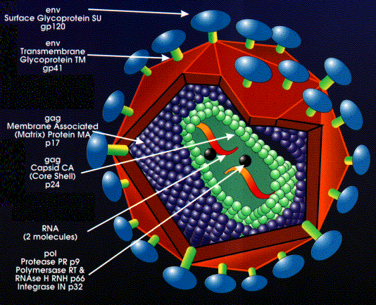
What is virus?
The word "virus" appeared in 1599 and originally meant "venom".
Small size: 20-400 nm
Viruses are submicroscopic, obligate intracellular parasites.
Viral proteins and nucleic acids
Viruses themselves can not grow or undergo division
Viruses lack the genetic information that encodes apparatus necessary for the generation of metabolic energy or for protein synthesis

Slide 7
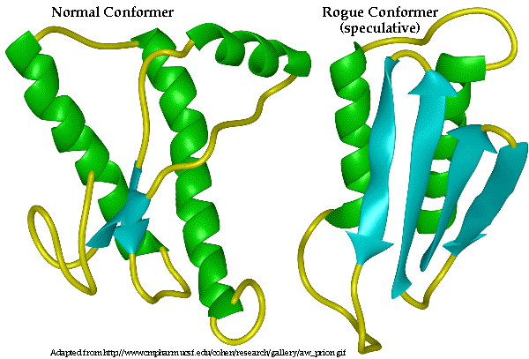
Subviral particles
Infectious entities notably smaller and simpler than viruses
Viroids: naked circular RNA molecules infecting plants
Satellites: nucleic acid molecules with or without a capsid that require a helper virus for infection and reproduction
Prions: proteins that can exist in a pathological conformation that induces other prion molecules to assume that same conformation

Slide 8
What does virology study:
Virology is the study of viruses and virus-like agents
Their structure, classification and evolution
Their ways to infect and exploit host cells for virus reproduction
Their interaction with host organism physiology and immunity
The diseases they cause
The techniques to isolate and culture them
Their use in research and therapy.
Virology is considered to be a subfield of microbiology or of medicine.

Slide 9
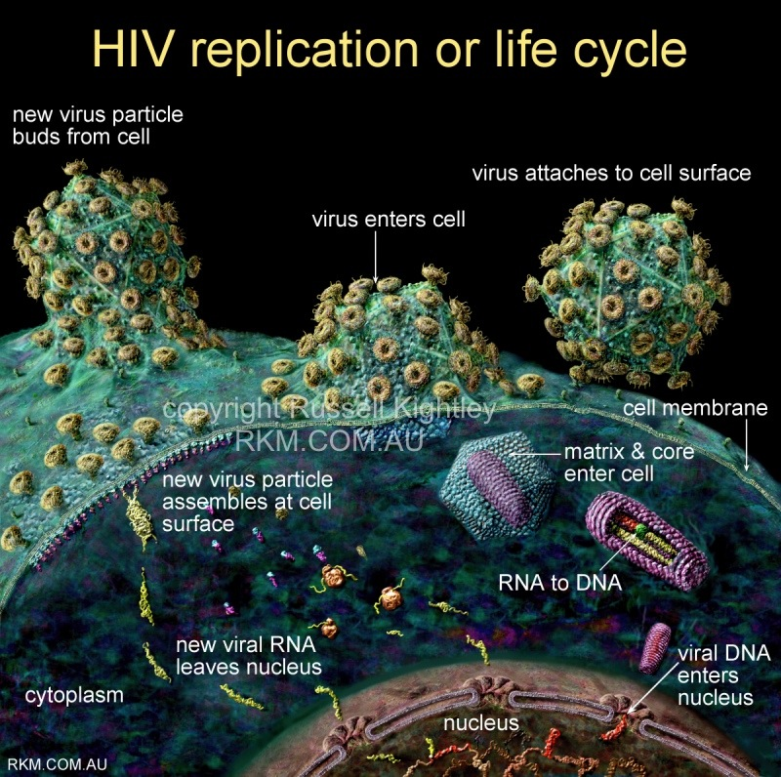

Slide 10
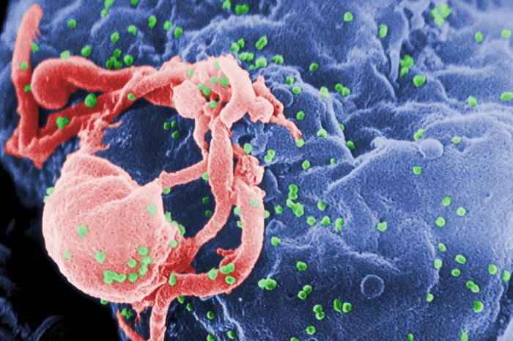
Scanning electron micrograph of HIV-1 virions budding from a cultured lymphocyte

Slide 11
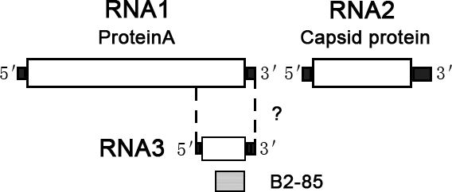
Simplicity is beautiful
suppress
trans activate
B1: unknown function
Example 1: Nodavirus genome and proteins

Slide 12
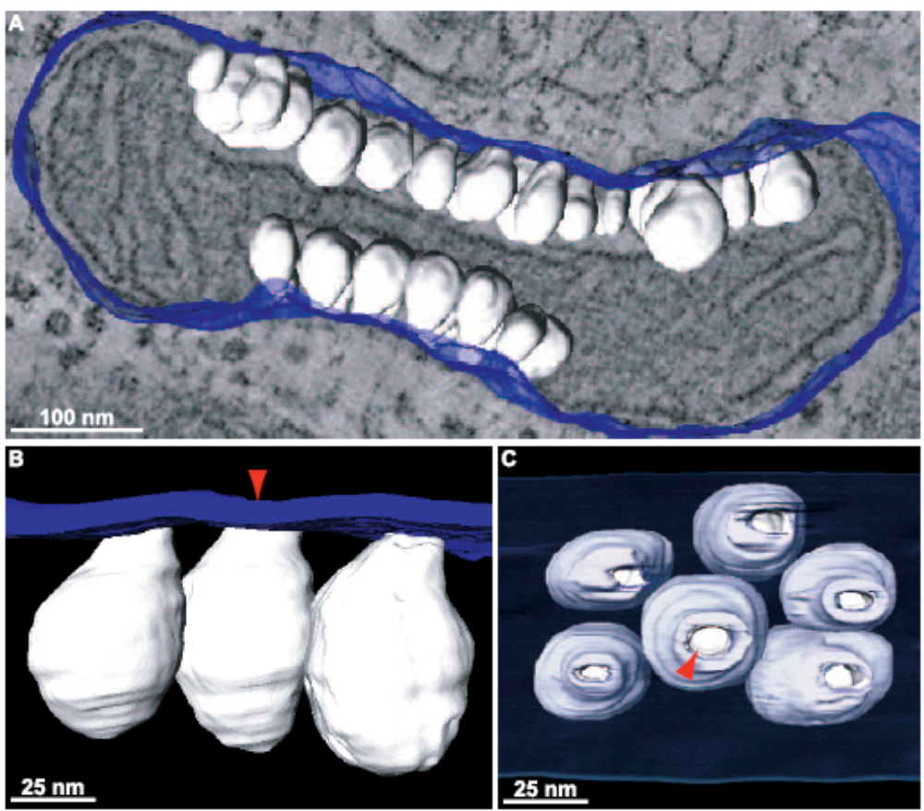
Simplicity is beautiful
Example 2: 3D maps of nodavirus-modified mitochondria

Slide 13
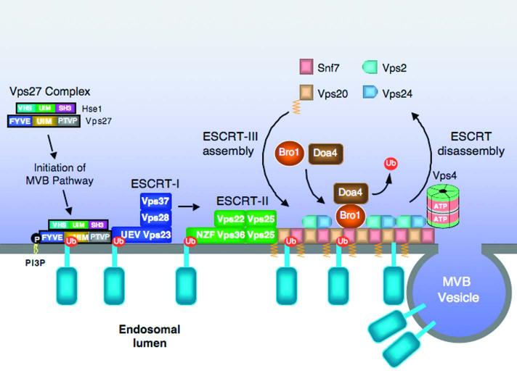
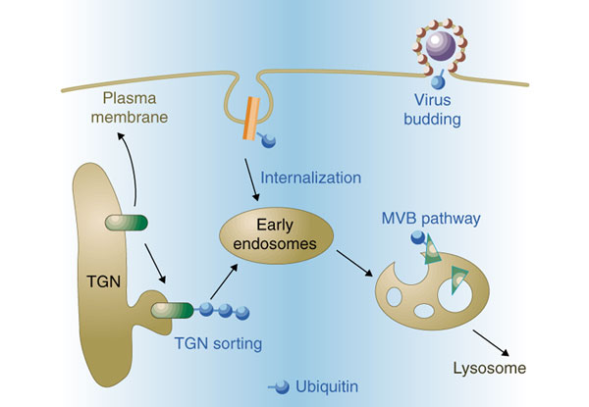
Simplicity is beautiful
Example 3: Retrovirus budding by hijacking ESCRT machinery

Slide 14
Hosts of viruses
Human
Vertebrate animal
Inverbrate animal (insect)
Plant
Fungi
Bacteria

Slide 15
What does medical virology study?
Viruses causing human diseases
Medical virology ≠ human virology
Antiviral therapies
Viral technologies that have medical implications

Slide 16
History (1)
3700 BC, First written record of a virus infection (a priest with poliomyelitis), Memphis, ancient Egypt;
1196 BC, Pharaoh Ramses V, smallpox
1000 BC, Smallpox was described as a contagious diseases by Chinese practitioners;
A very early form of vaccination known as variolation was developed several thousand years ago in China.
In 1717, Lady Mary Wortley Montagu observed the practice in Istanbul and attempted to popularize it in Britain, but encountered considerable resistance.
In 1796 Edward Jenner developed a much safer method, using cowpox to successfully immunize a young boy against smallpox, and this practice was widely adopted.
Vaccinations against other viral diseases followed, including the successful rabies vaccination by Louis Pasteur in 1886. The nature of viruses however was not clear to these researchers.

Slide 17
History (2)
In 1892, Russian scientist Dimitri Ivanovski showed "filterable agent" caused tobacco mosaic disease;
The existence of viruses that infect bacteria (bacteriophages) was first recognized by Frederick Twort in 1911, and, independently, by Felix d'Herelle in 1917.
1918 Spanish flu killed 3% to 6% of the entire global population (25 million death in its first 25 weeks, and 50—100 million in total); In late 1918, French scientists showed that a "filter-passing virus" could transmit the disease to people and animals;
In 1949 John F. Enders, Thomas Weller and Frederick Robbins reported growth of poliovirus in cultured human embryonal cells (They won Nobel Prize in 1954);
This work aided Jonas Salk in deriving a polio vaccine from deactivated polio viruses; this vaccine was shown to be effective in 1955. (Lasker Award in1956; founder of Salk Institute)

Slide 18
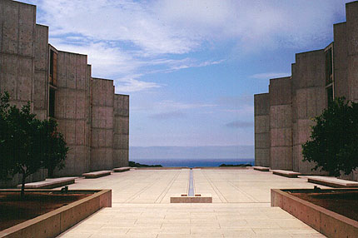
Salk Institute, La Jolla, California

Slide 19
History (3)
In 1963, the Hepatitis B virus was discovered by Baruch Blumberg (1976 Nobel Prize winner)
In 1965, Howard Temin described the first retrovirus (1975 Nobel Prize winner)
In 1975 the functioning of oncoviruses was clarified considerably
1976, the first recorded outbreak of Ebola hemorrhagic fever, a highly lethal virally transmitted disease.
In 1979, A worldwide vaccination campaign led by UN WHO resulted in the eradication of smallpo
In 1982, Stanley Prusiner discovered prions (1997 Nobel)
The first cases of AIDS were reported in 1981, and HIV, the retrovirus causing it, was identified in 1983 by Robert Gallo (Lasker) and Luc Montagnier (Nobel).
In 1987, Hepatitis C virus was identified

Slide 20
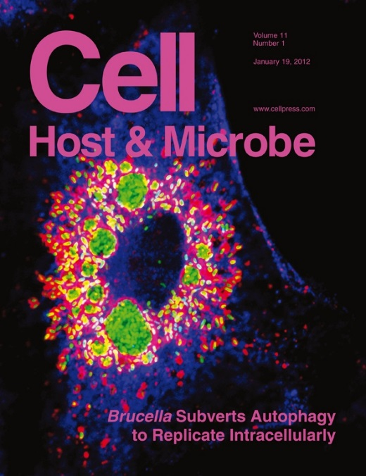
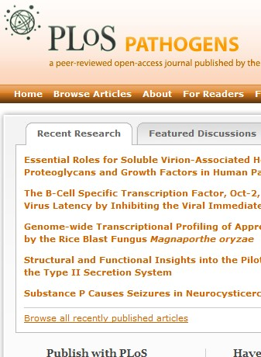
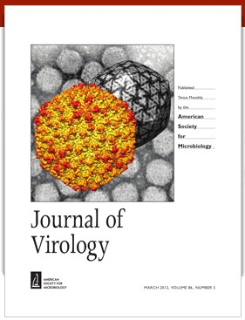
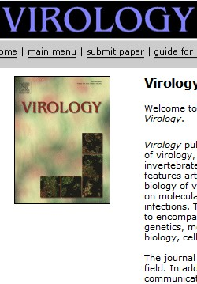
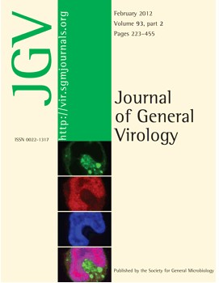
Major journals of virology

Slide 21
课程安排
普通医学病毒学（产生人类传染性疾病的病毒）
肿瘤病毒学（具有致癌作用的病毒）
医学病毒学的其他相关知识（抗病毒免疫、疫苗、抗病毒药物）

Slide 22
引言及课程简介
肝炎病毒（丙型、甲型及戊型等）
虫媒病毒（了解虫媒病毒的种类、感染及复制机制、与宿主相互作用等）
肠道病毒 （了解小RNA病毒的基本特征;重点掌握肠道病毒71型(EV71）的特征、感染及复制机制，以及致病机制）
痘病毒与生物反恐（天花、牛痘病毒）
抗病毒免疫（抗病毒天然免疫，获得性免疫，病毒逃避免疫监控的机制）
Notes:
第

Slide 23
肿瘤病毒学简介（什么是癌症，引起癌症的主要诱因有哪些；了解主要的肿瘤病毒；病毒诱发肿瘤的主要机制）
疱疹病毒与肿瘤（HHV-8 (KSHV)，HHV-4 (EBV)，HHV-5 (CMV)，其他HHV）
T细胞白血病病毒 （HTLV-1，HTLV-2，逆转录病毒的致癌机制，HTLV-1 Tax的致癌性），HIV，HBV等逆转录病毒致癌机制
人乳头瘤病毒（HPV与生殖系统肿瘤，HPV与口腔恶性肿瘤，HPV与皮肤癌，原癌基因E7, E6, E2, E5，HPV的感染、复制机制）
疫苗及抗病毒药物
特邀课：SARS-CoV、结构病毒及免疫学等

Slide 24

病毒肿瘤学教材

Slide 25
考核方式
考试成绩=1+2+3+4
平时表现：5%（随机签到，每次0.5-1%）
随堂小考：20%
期中考试：20%（开卷）
期末考试：55%（闭卷）

